Slide 1
Introduction to Machine Learning Course
1- Introduction
Lecturer: Batoul Diab

Slide 2
Course Outline
Introduction
Supervised Learning
Unsupervised Learning and Preprocessing
Representing Data and Engineering Features
Model Evaluation and Improvement
Algorithm Chains and Pipelines
Working with Text Data
Wrapping Up

Slide 3
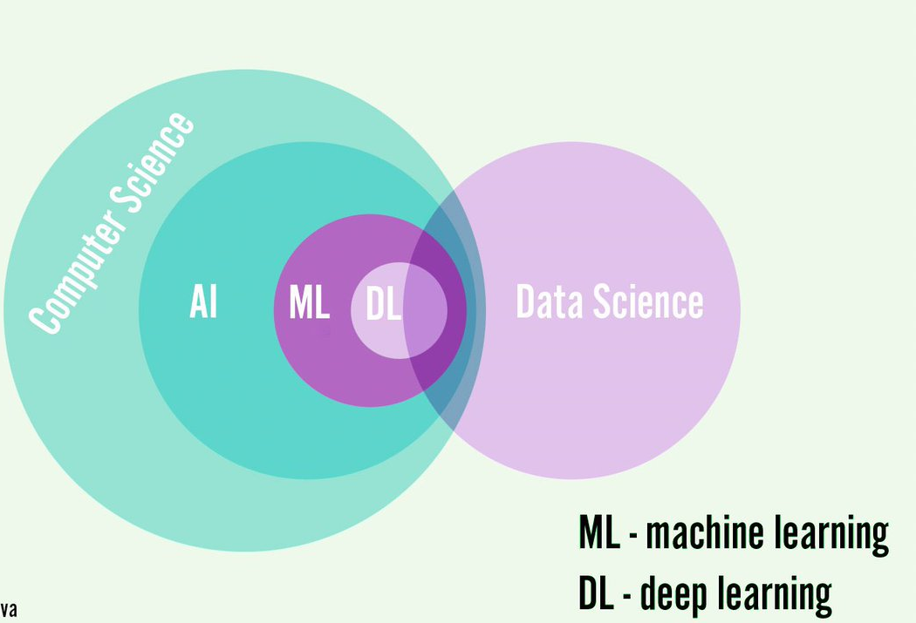
What is Machine Learning?
Extracting knowledge from data
Used in: recommendations, image recognition, research, etc.
Key domains: statistics, AI, computer science

Slide 4
Why Machine Learning?
Traditional rule-based systems are limited
ML adapts to complex tasks (e.g., face detection)
Learns patterns automatically from data

Slide 5
Supervised vs Unsupervised Learning
Supervised: Input + Output pairs (e.g., disease or spam detection)
Unsupervised: Only input data (e.g., customer segmentation)
Fasting Blood Glucose | HbA1c (A1c) | Oral Glucose Tolerance Test (OGTT) | diabetic
180 mg/dL | 10% | 250 mg/dL | yes
90 mg/dL | 5% | 170 mg/dL | No
Age | Gender | Interests
18 | Female | Gaming
22 | Female | Fashion

Slide 6
Examples of ML Applications
Handwritten digit recognition (e.g., zip code)
Medical diagnosis
Fraud detection
Customer grouping
Anomaly detection

Slide 7
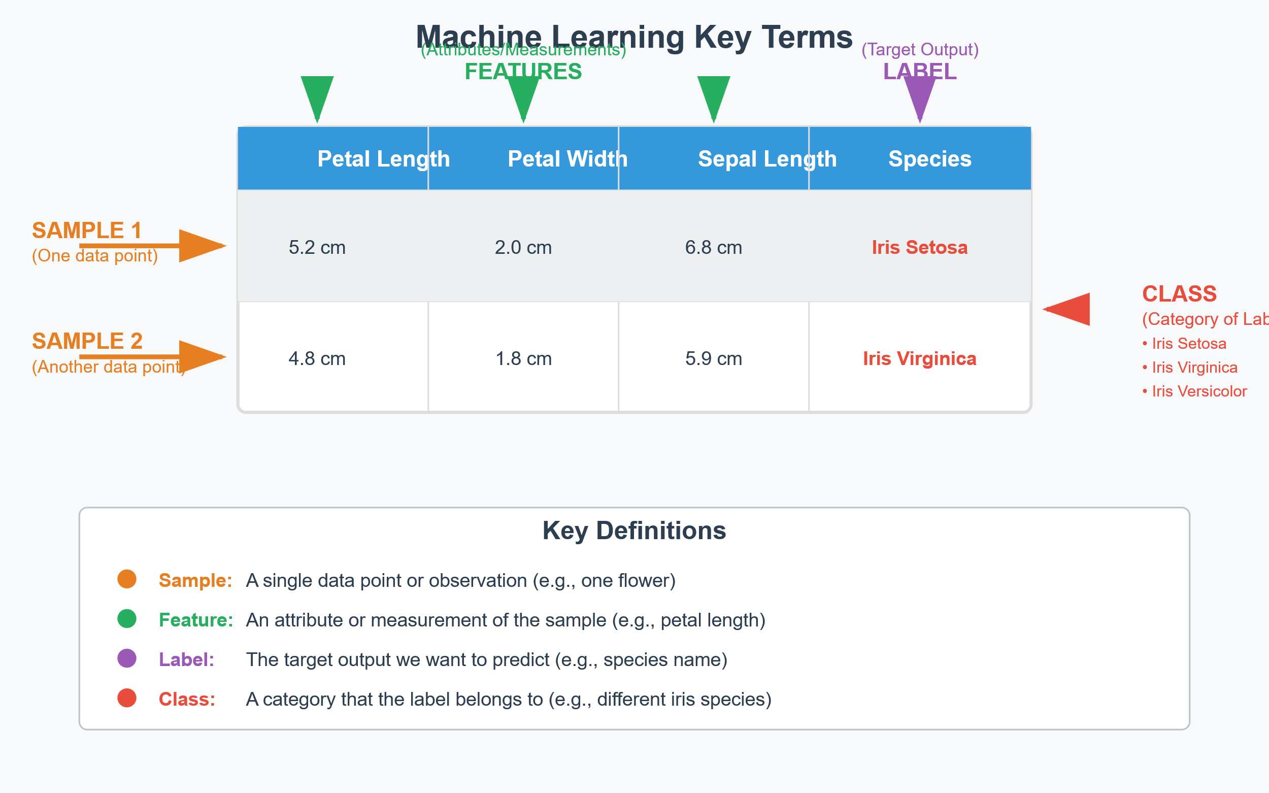
Key Terms
Sample: A data point (e.g., a flower)
Feature: An attribute (e.g., petal length)
Label: Target output (e.g., species name)
Class: Category of labels

Slide 8
Importance of Understanding Data
Ask the right questions
Ensure data quality
Match features to problem
Define success metrics

Slide 9
Why Python?
Easy to use and widely adopted
Rich ecosystem: NumPy, pandas, matplotlib, Jupyter
Excellent for prototyping and production

Slide 10
scikit-learn
Open-source ML library
Simple API for training and prediction
Integrates well with other Python tools

Slide 11
Essential Libraries
pip install numpy scipy matplotlib ipython scikit-learn pandas notebook mglearn
NumPy: Numerical arrays
SciPy: Scientific computations
matplotlib: Visualizations
pandas: Data manipulation
Jupyter Notebook: Interactive coding
mglearn: Utility library used in examples

Slide 12
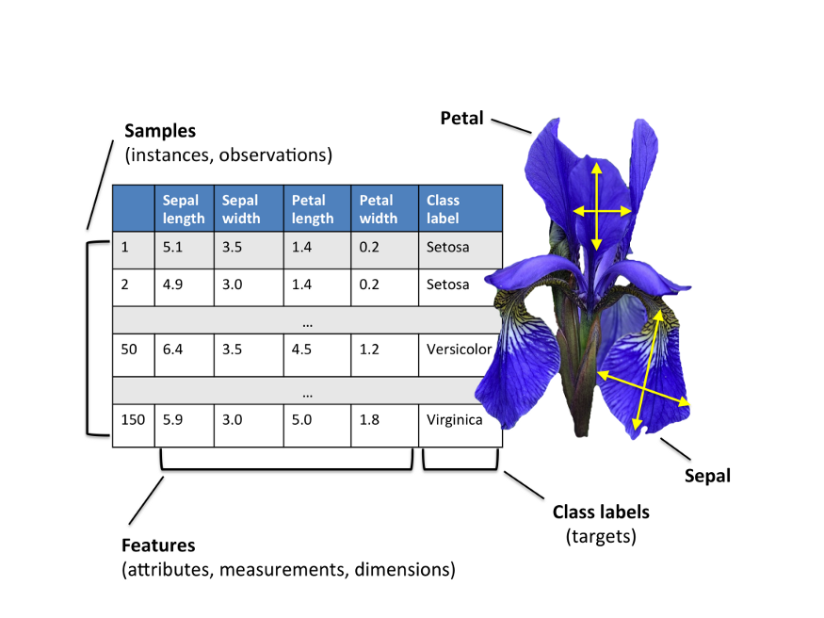
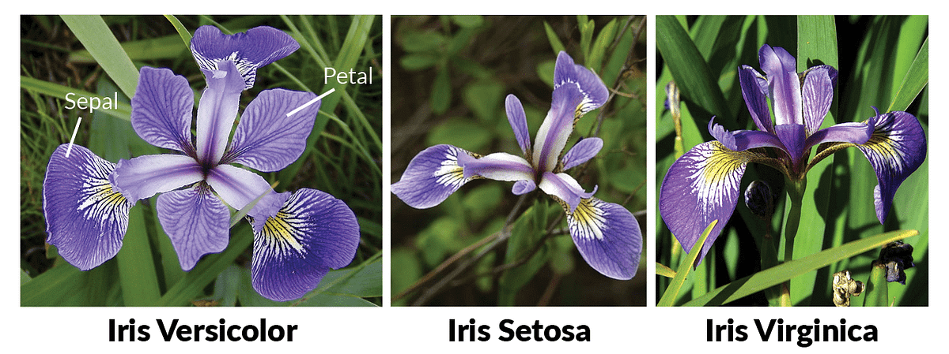
First ML Application – Iris Dataset
Goal: Predict species of iris flower
Features: sepal length/width, petal length/width
Classes: setosa, versicolor, virginica

Slide 13
Building the Model
Run command: python -m notebook
Step 1: Split data (training/testing)
Step 2: Choose model (k-Nearest Neighbors)
Step 3: Fit model to training data
Step 4: Predict and evaluate

Slide 14
Results and Evaluation
Achieved ~% accuracy
Demonstrates power of ML even with a simple model

Slide 15
Summary
ML automates decision-making from data
Python + scikit-learn = fast development
Understand your data, task, and evaluation criteria

